Slide 1
Multiple Alignment

Slide 2
Outline
Dynamic Programming in 3-D
Progressive Alignment
Profile Progressive Alignment (ClustalW)
Scoring Multiple Alignments
Entropy
Sum of Pairs Alignment
Partial Order Alignment (POA)
A-Bruijin (ABA) Approach to Multiple Alignment

Slide 3


Multiple Alignment versus Pairwise Alignment
Up until now we have only tried to align two sequences.

Slide 4


Multiple Alignment versus Pairwise Alignment
Up until now we have only tried to align two sequences.
What about more than two? And what for?

Slide 5
Multiple Alignment versus Pairwise Alignment
Up until now we have only tried to align two sequences.
What about more than two? And what for?
A faint similarity between two sequences becomes significant if present in many
Multiple alignments can reveal subtle similarities that pairwise alignments do not reveal

Slide 6
Generalizing the Notion of Pairwise Alignment
Alignment of 2 sequences is represented as a
2-row matrix
In a similar way, we represent alignment of 3 sequences as a 3-row matrix
A T _ G C G _
A _ C G T _ A
A T C A C _ A
Score: more conserved columns, better alignment

Slide 7
Alignments = Paths in…
Align 3 sequences: ATGC, AATC,ATGC
 | A | -- | T | G | C
 | A | A | T | -- | C
 | -- | A | T | G | C

Slide 8
Alignment Paths
0 | 1 | 1 | 2 | 3 | 4
x coordinate
 | A | -- | T | G | C
 | A | A | T | -- | C
 | -- | A | T | G | C

Slide 9
Alignment Paths
Align the following 3 sequences:
ATGC, AATC,ATGC
0 | 1 | 1 | 2 | 3 | 4
x coordinate
 | A | -- | T | G | C
0 | 1 | 2 | 3 | 3 | 4
y coordinate
 | A | A | T | -- | C
 | -- | A | T | G | C

Slide 10
Alignment Paths
0 | 1 | 1 | 2 | 3 | 4
x coordinate
 | A | -- | T | G | C
0 | 1 | 2 | 3 | 3 | 4
y coordinate
 | A | A | T | -- | C
0 | 0 | 1 | 2 | 3 | 4
z coordinate
 | -- | A | T | G | C
Resulting path in (x,y,z) space:
(0,0,0)→(1,1,0)→(1,2,1) →(2,3,2) →(3,3,3) →(4,4,4)

Slide 11
Aligning Three Sequences
source
Same strategy as aligning two sequences
Use a 3-D “Manhattan Cube”, with each axis representing a sequence to align
For global alignments, go from source to sink
sink

Slide 12
2-D vs 3-D Alignment Grid
V
W
2-D edit graph
3-D edit graph

Slide 13
2-D cell versus 2-D Alignment Cell
In 2-D, 3 edges in each unit square
In 3-D, 7 edges in each unit cube

Slide 14
Architecture of 3-D Alignment Cell
(i-1,j-1,k-1)
(i-1,j,k-1)
(i-1,j-1,k)
(i-1,j,k)
(i,j,k-1)
(i,j-1,k-1)
(i,j-1,k)
(i,j,k)

Slide 15
Multiple Alignment: Dynamic Programming
cube diagonal: no indels
s_{i,j,k} = max
δ(x, y, z) is an entry in the 3-D scoring matrix
s_{i-1,j-1,k-1} + δ(v_{i}, w_{j}, u_{k})
s_{i-1,j-1,k} + δ (v_{i}, w_{j}, _ )
s_{i-1,j,k-1} + δ (v_{i}, _, u_{k})
s_{i,j-1,k-1} + δ (_, w_{j}, u_{k})
s_{i-1,j,k} + δ (v_{i}, _ , _)
s_{i,j-1,k} + δ (_, w_{j}, _)
s_{i,j,k-1} + δ (_, _, u_{k})
face diagonal: one indel
edge diagonal: two indels

Slide 16
Multiple Alignment: Running Time
For 3 sequences of length n, the run time is 7n³; O(n³)
For k sequences, build a k-dimensional Manhattan, with run time (2^{k}-1)(n^{k}); O(2^{k}n^{k})
Conclusion: dynamic programming approach for alignment between two sequences is easily extended to k sequences but it is impractical due to exponential running time

Slide 17
Multiple Alignment Induces Pairwise Alignments
Every multiple alignment induces pairwise alignments
x: AC-GCGG-C
y: AC-GC-GAG
z: GCCGC-GAG
Induces:
x: ACGCGG-C; x: AC-GCGG-C; y: AC-GCGAG
y: ACGC-GAC; z: GCCGC-GAG; z: GCCGCGAG

Slide 18
Reverse Problem: Constructing Multiple Alignment from Pairwise Alignments
Given 3 arbitrary pairwise alignments:
x: ACGCTGG-C; x: AC-GCTGG-C; y: AC-GC-GAG
y: ACGC--GAC; z: GCCGCA-GAG; z: GCCGCAGAG
can we construct a multiple alignment that induces
them?

Slide 19
Reverse Problem: Constructing Multiple Alignment from Pairwise Alignments
Given 3 arbitrary pairwise alignments:
x: ACGCTGG-C; x: AC-GCTGG-C; y: AC-GC-GAG
y: ACGC--GAC; z: GCCGCA-GAG; z: GCCGCAGAG
can we construct a multiple alignment that induces
them?
NOT ALWAYS
Pairwise alignments may be inconsistent

Slide 20
Inferring Multiple Alignment from Pairwise Alignments
From an optimal multiple alignment, we can infer pairwise alignments between all pairs of sequences, but they are not necessarily optimal
It is difficult to infer a ``good” multiple alignment from optimal pairwise alignments between all sequences

Slide 21
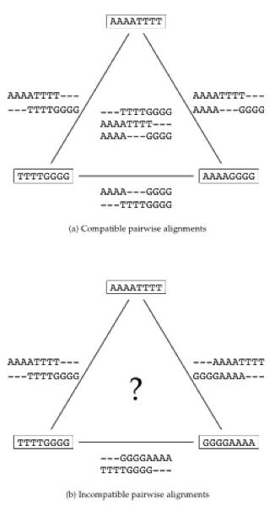
Combining Optimal Pairwise Alignments into Multiple Alignment
Can combine pairwise alignments into multiple alignment
Can not combine pairwise alignments into multiple alignment

Slide 22
Profile Representation of Multiple Alignment
- A G G C T A T C A C C T G
T A G – C T A C C A - - - G
C A G – C T A C C A - - - G
C A G – C T A T C A C – G G
C A G – C T A T C G C – G G
A 1 1 .8
C .6 1 .4 1 .6 .2
G 1 .2 .2 .4 1
T .2 1 .6 .2
- .2 .8 .4 .8 .4

Slide 23
Profile Representation of Multiple Alignment
- A G G C T A T C A C C T G
T A G – C T A C C A - - - G
C A G – C T A C C A - - - G
C A G – C T A T C A C – G G
C A G – C T A T C G C – G G
A 1 1 .8
C .6 1 .4 1 .6 .2
G 1 .2 .2 .4 1
T .2 1 .6 .2
- .2 .8 .4 .8 .4
In the past we were aligning a sequence against a sequence
Can we align a sequence against a profile?
Can we align a profile against a profile?

Slide 24
Aligning alignments
Given two alignments, can we align them?
x GGGCACTGCAT
y GGTTACGTC-- Alignment 1
z GGGAACTGCAG
w GGACGTACC-- Alignment 2
v GGACCT-----

Slide 25
Aligning alignments
Given two alignments, can we align them?
Hint: use alignment of corresponding profiles
x GGGCACTGCAT
y GGTTACGTC-- Combined Alignment
z GGGAACTGCAG
w GGACGTACC--
v GGACCT-----

Slide 26
Multiple Alignment: Greedy Approach
Choose most similar pair of strings and combine into a profile , thereby reducing alignment of k sequences to an alignment of of k-1 sequences/profiles. Repeat
This is a heuristic greedy method
u₁= ACGTACGTACGT…
u₂ = TTAATTAATTAA…
u₃ = ACTACTACTACT…
…
u_{k} = CCGGCCGGCCGG
u₁= ACg/tTACg/tTACg/cT…
u₂ = TTAATTAATTAA…
…
u_{k} = CCGGCCGGCCGG…
k-1
k

Slide 27
Greedy Approach: Example
Consider these 4 sequences
s1 GATTCA
s2 GTCTGA
s3 GATATT
s4 GTCAGC

Slide 28
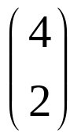
Greedy Approach: Example (cont’d)
There are = 6 possible alignments
s2 GTCTGA
s4 GTCAGC (score = 2)
s1 GAT-TCA
s2 G-TCTGA (score = 1)
s1 GAT-TCA
s3 GATAT-T (score = 1)
s1 GATTCA--
s4 G—T-CAGC(score = 0)
s2 G-TCTGA
s3 GATAT-T (score = -1)
s3 GAT-ATT
s4 G-TCAGC (score = -1)

Slide 29
Greedy Approach: Example (cont’d)
s₂ and s₄ are closest; combine:
s2 GTCTGA
s4 GTCAGC
s_{2,4} GTCt/aGa/cA (profile)
new set of 3 sequences:
s₁ GATTCA
s₃ GATATT
s_{2,4} GTCt/aGa/c

Slide 30
Progressive Alignment
Progressive alignment is a variation of greedy algorithm with a somewhat more intelligent strategy for choosing the order of alignments.
Progressive alignment works well for close sequences, but deteriorates for distant sequences
  Gaps in consensus string are permanent
  Use profiles to compare sequences

Slide 31
ClustalW
Popular multiple alignment tool today
‘W’ stands for ‘weighted’ (different parts of alignment are weighted differently).
Three-step process
  1.) Construct pairwise alignments
  2.) Build Guide Tree
  3.) Progressive Alignment guided by the tree

Slide 32
Step 1: Pairwise Alignment
Aligns each sequence again each other giving a similarity matrix
Similarity = exact matches / sequence length (percent identity)
v₁ v₂ v₃ v₄
v₁ -
v₂ .17 -
v₃ .87 .28 -
v₄ .59 .33 .62 -
(.17 means 17 % identical)

Slide 33
Step 2: Guide Tree
Create Guide Tree using the similarity matrix
  ClustalW uses the neighbor-joining method
  Guide tree roughly reflects evolutionary relations

Slide 34
Step 2: Guide Tree (cont’d)
v₁
v₃
v₄
v₂
v₁ v₂ v₃ v₄
v₁ -
v₂ .17 -
v₃ .87 .28 -
v₄ .59 .33 .62 -
Calculate:
v_{1,3} = alignment (v₁, v₃)
v_{1,3,4} = alignment((v_{1,3}),v₄)
v_{1,2,3,4} = alignment((v_{1,3,4}),v₂)

Slide 35
Step 3: Progressive Alignment
Start by aligning the two most similar sequences
Following the guide tree, add in the next sequences, aligning to the existing alignment
Insert gaps as necessary
FOS_RAT PEEMSVTS-LDLTGGLPEATTPESEEAFTLPLLNDPEPK-PSLEPVKNISNMELKAEPFD
FOS_MOUSE PEEMSVAS-LDLTGGLPEASTPESEEAFTLPLLNDPEPK-PSLEPVKSISNVELKAEPFD
FOS_CHICK SEELAAATALDLG----APSPAAAEEAFALPLMTEAPPAVPPKEPSG--SGLELKAEPFD
FOSB_MOUSE PGPGPLAEVRDLPG-----STSAKEDGFGWLLPPPPPPP-----------------LPFQ
FOSB_HUMAN PGPGPLAEVRDLPG-----SAPAKEDGFSWLLPPPPPPP-----------------LPFQ
. . : ** . :.. *:.* * . * **:
Dots and stars show how well-conserved a column is.

Slide 36
Multiple Alignments: Scoring
Number of matches (multiple longest common subsequence score)
Entropy score
Sum of pairs (SP-Score)

Slide 37
Multiple LCS Score
A column is a “match” if all the letters in the column are the same
Only good for very similar sequences
AAA
AAA
AAT
ATC

Slide 38
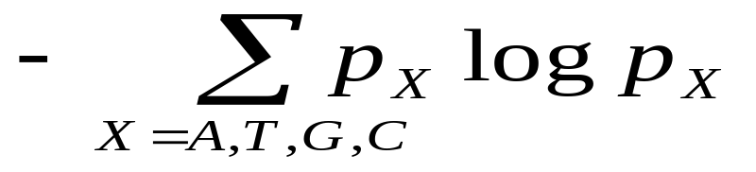
Entropy
Define frequencies for the occurrence of each letter in each column of multiple alignment
  p_{A} = 1, p_{T}=p_{G}=p_{C}=0 (1st column)
  p_{A} = 0.75, p_{T} = 0.25, p_{G}=p_{C}=0 (2nd column)
  p_{A} = 0.50, p_{T} = 0.25, p_{C}=0.25 p_{G}=0 (3rd column)
Compute entropy of each column
AAA
AAA
AAT
ATC

Slide 39
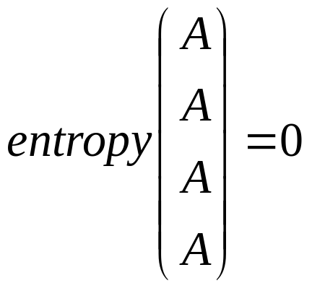
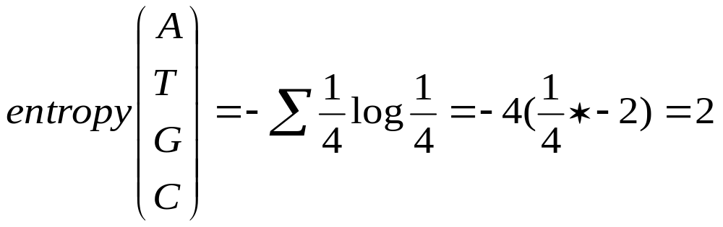
Entropy: Example
Best case
Worst case

Slide 40
Multiple Alignment: Entropy Score
Entropy for a multiple alignment is the sum of entropies of its columns:
Σ _{over all columns} Σ _{X=A,T,G,C} p_{X} logp_{X}

Slide 41
Entropy of an Alignment: Example
column entropy:
-( p_{A}logp_{A} + p_{C}logp_{C} + p_{G}logp_{G} + p_{T}logp_{T})
A | A | A
A | C | C
A | C | G
A | C | T
Column 1 = -[1*log(1) + 0*log0 + 0*log0 +0*log0]
= 0
Column 2 = -[(¹/₄)*log(¹/₄) + (³/₄)*log(³/₄) + 0*log0 + 0*log0]
= -[ (¹/₄)*(-2) + (³/₄)*(-.415) ] = +0.811
Column 3 = -[(¹/₄)*log(¹/₄)+(¹/₄)*log(¹/₄)+(¹/₄)*log(¹/₄) +(¹/₄)*log(¹/₄)] = 4* -[(¹/₄)*(-2)] = +2.0
Alignment Entropy = 0 + 0.811 + 2.0 = +2.811

Slide 42
Multiple Alignment Induces Pairwise Alignments
Every multiple alignment induces pairwise alignments
x: AC-GCGG-C
y: AC-GC-GAG
z: GCCGC-GAG
Induces:
x: ACGCGG-C; x: AC-GCGG-C; y: AC-GCGAG
y: ACGC-GAC; z: GCCGC-GAG; z: GCCGCGAG

Slide 43
Inferring Pairwise Alignments from Multiple Alignments
From a multiple alignment, we can infer pairwise alignments between all sequences, but they are not necessarily optimal
This is like projecting a 3-D multiple alignment path on to a 2-D face of the cube

Slide 44
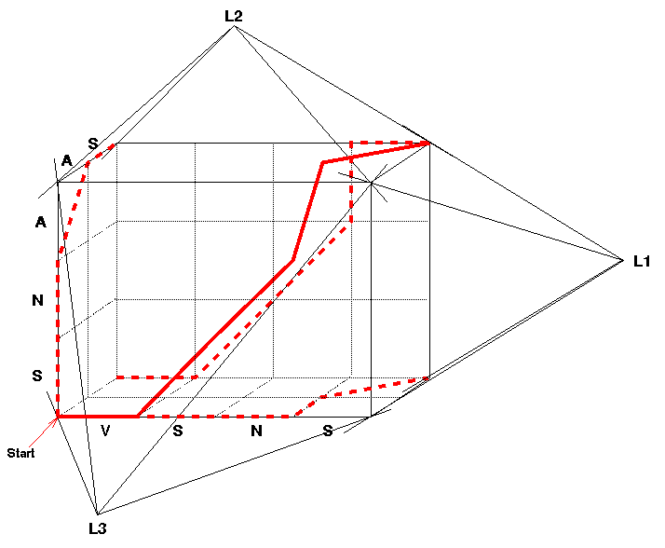
Multiple Alignment Projections
A 3-D alignment can be projected onto the 2-D plane to represent an alignment between a pair of sequences.
All 3 Pairwise Projections of the Multiple Alignment

Slide 45
Sum of Pairs Score(SP-Score)
Consider pairwise alignment of sequences
a_{i} and a_{j}
imposed by a multiple alignment of k sequences
Denote the score of this suboptimal (not necessarily optimal) pairwise alignment as
s*(a_{i}, a_{j})
Sum up the pairwise scores for a multiple alignment:
s(a₁,…,a_{k}) = Σ_{i,j} s*(a_{i}, a_{j})

Slide 46
Computing SP-Score
Aligning 4 sequences: 6 pairwise alignments
Given a₁,a₂,a₃,a₄:
s(a₁…a₄) = Σs*(a_{i},a_{j}) = s*(a₁,a₂) + s*(a₁,a₃)
+ s*(a₁,a₄) + s*(a₂,a₃)
+ s*(a₂,a₄) + s*(a₃,a₄)

Slide 47
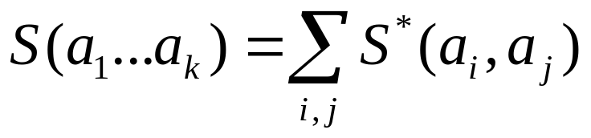
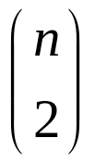
SP-Score: Example
a₁
.
a_{k}
ATG-C-AAT
A-G-CATAT
ATCCCATTT
To calculate each column:
s
s*(
Pairs of Sequences
A
G
1
Score=3
1
−μ
1
Score = 1 – 2μ
A
1
A
C
−μ
G
Column 1
Column 3

